Slide 1

Orbital Object Classification and Analysis
TSgt Eric Baldwin

Slide 2
QUESTION
Can I classify space objects into two categories: payloads and non-payloads (debris, rocket bodies, and unknown objects) based on their orbital characteristics?

Slide 3
Dataset
The dataset contains 14,372 orbital space objects.
Launch Dates range from 1961 – 2021.
Some key data points include:
'INCLINATION’
'PERIOD_HOURS’
'ALTITUDE_MI’
'ECCENTRICITY’
'RA_OF_ASC_NODE’
'ARG_OF_PERICENTER’
'MEAN_ANOMALY’
'SEMIMAJOR_AXIS’
'APOAPSIS’
‘RCS_SIZE’ (RCS - Radar Cross Section)

Slide 4
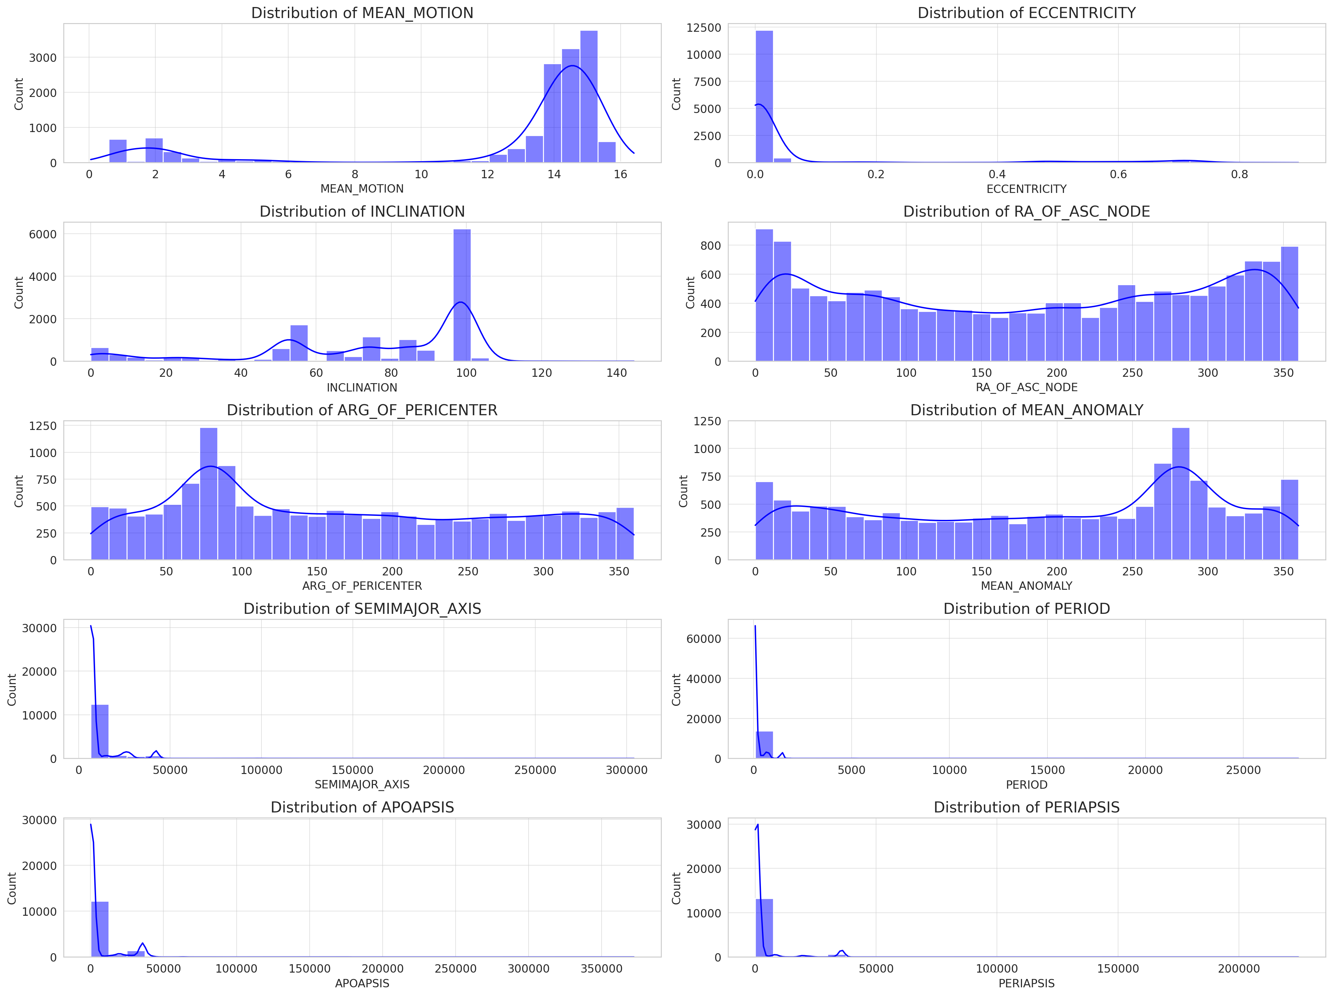
EDA of Orbital Characteristics

Slide 5
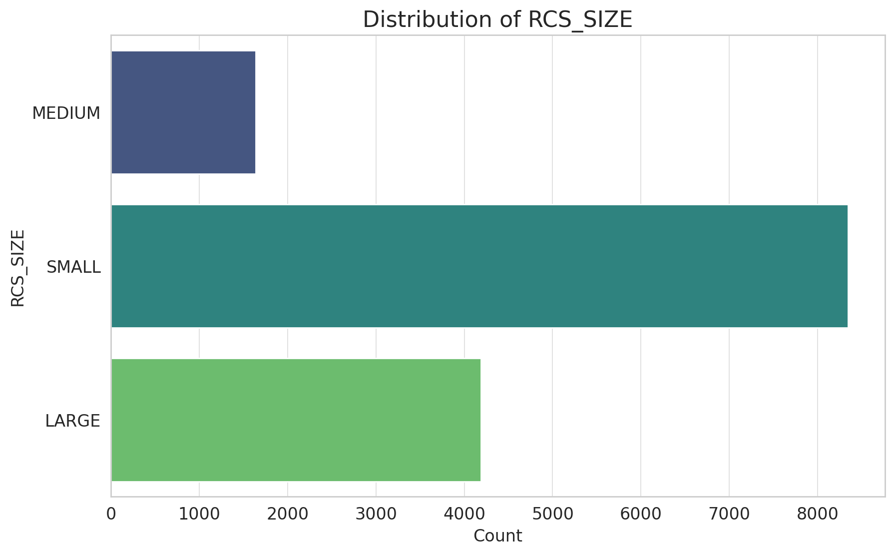
EDA of Radar Cross Section

Slide 6
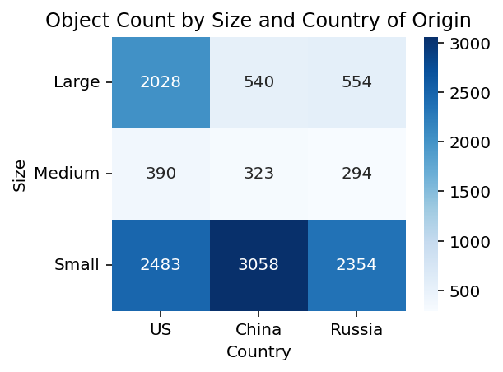
EDA of Objects by Size & Origin

Slide 7
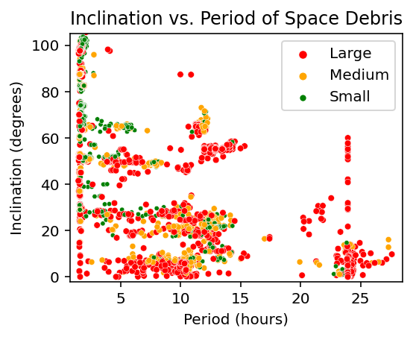
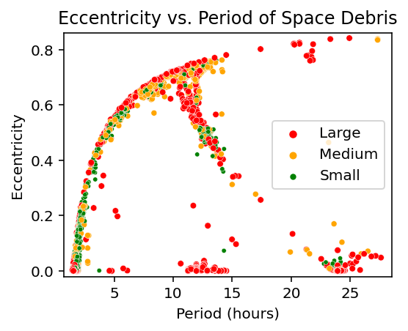
EDA of Space Object Orbit

Slide 8
Modeling the Data
My project employs logistic regression and evaluates its performance using precision, recall, and F1-score. I achieved 84% accuracy which indicates that the model performs well as indicated in the classification report.
Logistic Regression Classification Report:
precision recall f1-score support
0.0 0.84 0.83 0.84 2824
1.0 0.83 0.84 0.84 2830
accuracy 0.84 5654
macro avg 0.84 0.84 0.84 5654
weighted avg 0.84 0.84 0.84 5654

Slide 9
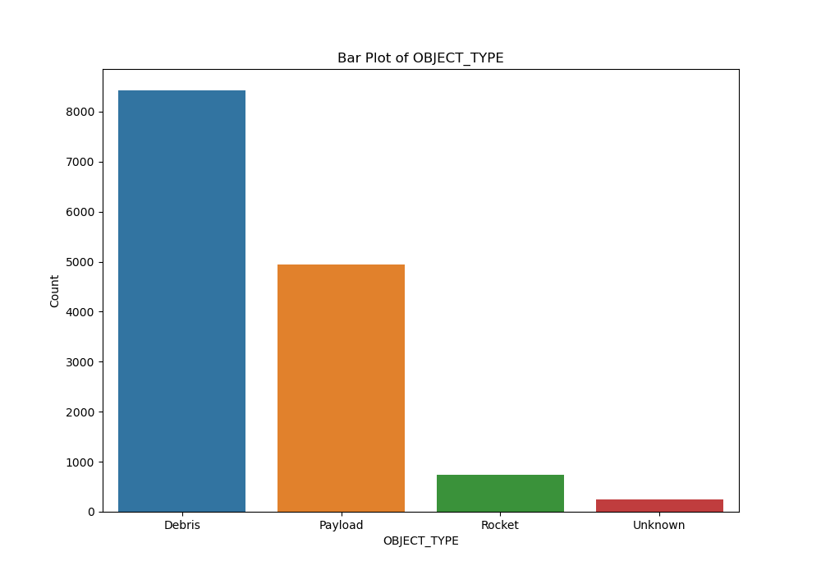
Object Analysis Results

Slide 10
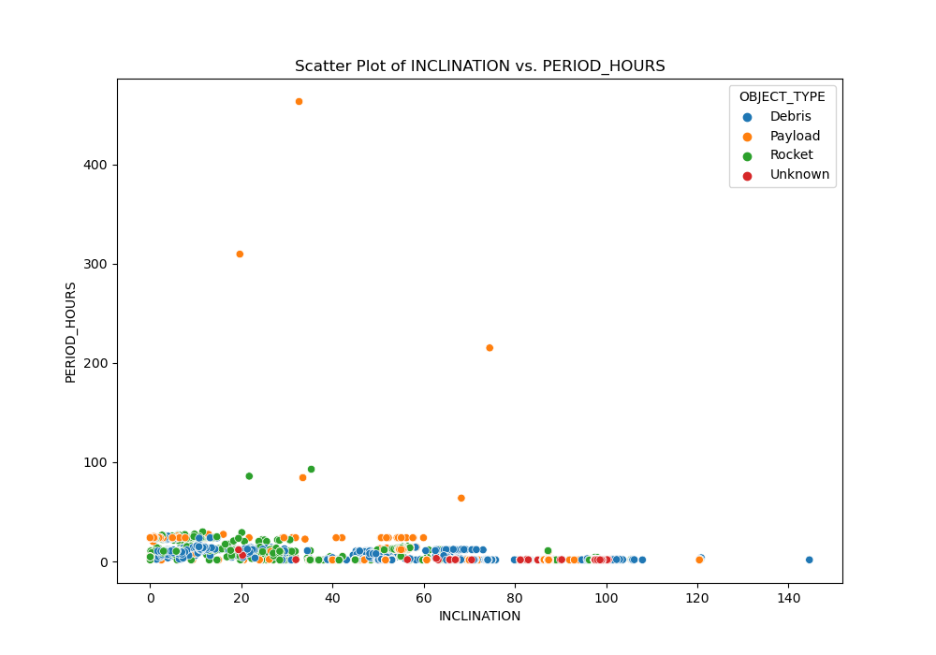
Object Analysis Results

Slide 11
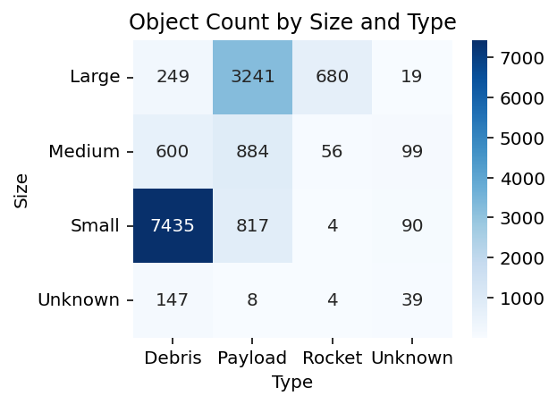
Analysis of Objects by Size & Type

Slide 12
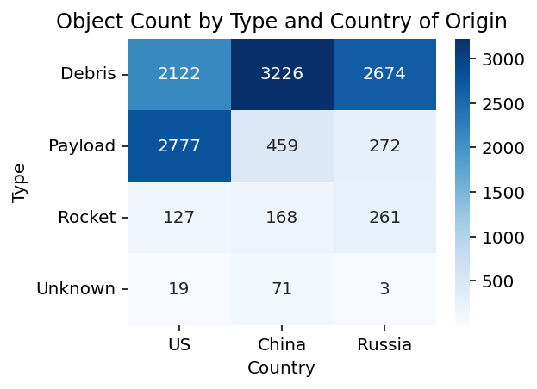
Analysis of Objects by Size & Origin

Slide 13
ANSWER
Through the modeling and analysis, I performed, my project demonstrates the feasibility of accurately classifying orbital objects using logistic regression with 84% accuracy.

Slide 14

Thank you
TSgt Eric Baldwin
937-789-0108
DATASET - https://www.kaggle.com/datasets/kandhalkhandeka/satellites-and-debris-in-earths-orbit
Eric.Baldwin.1@spaceforce.mil
GITHUB - https://github.com/Eric-Baldwin/Orbital_Debris_Categorization_and_Analysis
APP URL - https://orbital-debris-categorization-and-yg2z.onrender.com/docs

